Slide 1
Yukon First Nation
Engagement and Consultation Guide
An Innovative Approach
PDAC
March 6, 2018
Notes:
Steve

Slide 2
Introductions
Moderator:
Stephen Morison, SRM Consulting Ltd.
Panelists:
Sue Craig, Yukon Chamber of Mines
Judy Gingell, Judy Gingell Consulting Inc.
Emmie Fairclough, Teslin Tlingit Council
PDAC
March 6, 2018
Notes:
STEVE

Slide 3
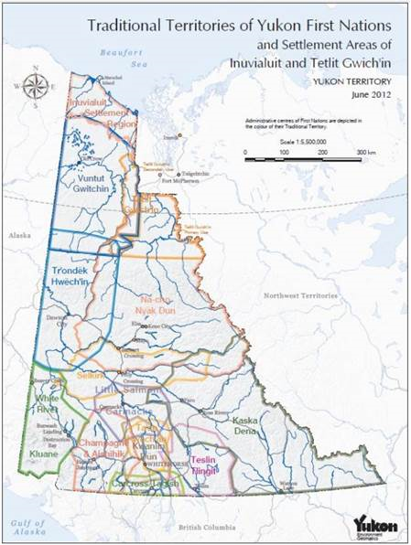
Innovative Web Based Approach
Project Theme:
“Partnerships through clear and consistent communications, with trust, respect, careful listening and an open mind”
www.archbouldphotography.com
PDAC
March 6, 2018
Notes:
STEVE

Slide 4
Project Support
Project is funded by:
Yukon Chamber of Mines
Canadian Northern Economic Development Agency &
Energy, Mines and Resources, Yukon Government
www.archbouldphotography.com
PDAC
March 6, 2018
Notes:
SUE

Slide 5
Project Objectives
Contribute to an attractive investment climate for the exploration and mining industry in Yukon.
Provide a guide that will facilitate strong and healthy relationships between the mineral exploration industry and Yukon First Nations.
Provide an innovative hard copy guidebook with an integrated web based tool for effective engagement with Yukon First Nations.
A Mobile Application or APP will also be available as a tool for engagement and consultation.
www.archbouldphotography.com
PDAC
March 6, 2018
Notes:
SUE

Slide 6
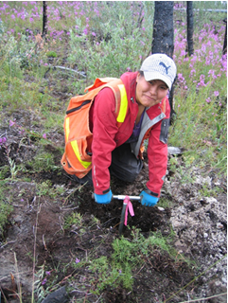
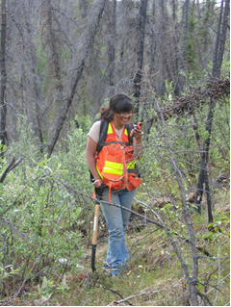
Exploration Industry-First Nation Relationships in Yukon
Facts:
First Nations are significant rights holders in Yukon through the completion of the Umbrella Final Agreement or UFA.
The UFA includes permanent mineral rights to nearly 24,000 km² for Category A Lands.
That’s equivalent to nearly124,000 mining claims (currently 186,700 claims in Yukon).
www.archbouldphotography.com
PDAC
March 6, 2018
Notes:
SUE

Slide 7
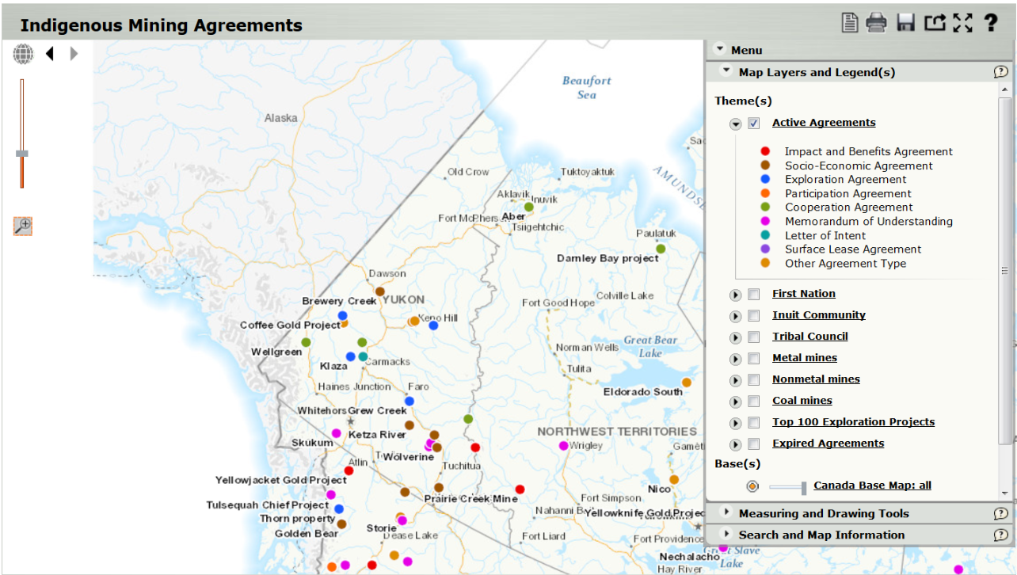
Mining Industry Relationships
www.archbouldphotography.com
PDAC
March 6, 2018
Notes:
SUE

Slide 8
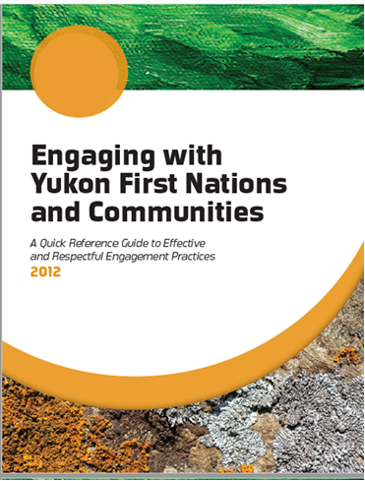
Why This Guide Now
Yukon Chamber of Mines partnered with Tr’ondëk Hwëch’in First Nation and Nacho Nyak Dun First Nation producing this 2012 Guide.
This project will expand on this previous work by utilizing examples, case histories and direct contact with First Nations Government, Yukon Government, Federal Government and Industry participants to guide in the scoping, development and building of both the engagement process and consultation programs.
www.archbouldphotography.com
PDAC
March 6, 2018
Notes:
SUE

Slide 9
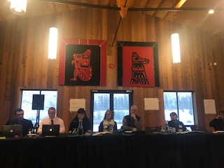
Why This Guide is Different
The consulting team has extensive experience in First Nations engagement and includes a respected elder and political leader, Judy Gingell.
First Nations involvement in the Guide is critical for this project, which has included:
Community meetings with the consulting team.
First Nations leadership meetings with the consulting team.
A First Nations workshop to ensure the products are meeting the requirements and issues around engagement and consultation.
This project has engaged with 17 First Nations in Yukon., Northern British Columbia and NWT.
www.archbouldphotography.com
PDAC
March 6, 2018
Notes:
SUE

Slide 10
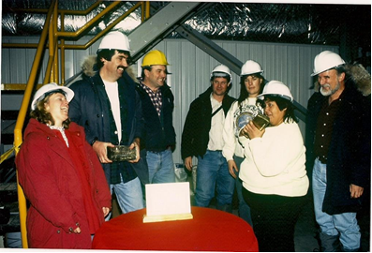
Key Messages: What We Heard
Start early
Take time
Be patient
Get to know the local community at a “people” level
Join community key events & celebrations
Keep it simple
Know what the project can withstand
www.archbouldphotography.com
PDAC
March 6, 2018
Notes:
SUE

Slide 11
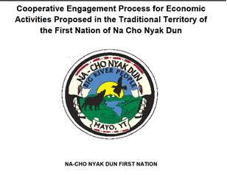
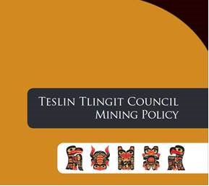
Web Based Guide:
Traditional Territories Based
Integrated web based Guide will provide:
Direct linkages to existing First Nation government’s legislation, policies, tools, examples and other sources of information.
Tools, ideas, and examples to promote partnerships between Yukon’s Exploration Industry and First Nations.
Direct linkages to other government information including legislation, regulations and policies.
Interactive web based application to assist with the design and implementation of engagement and consultation programs.
PDAC
March 6, 2018
Notes:
SUE

Slide 12
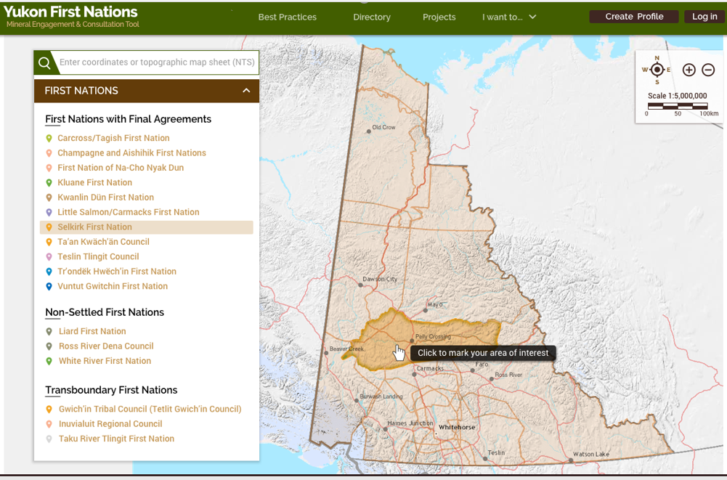
The Look…
www.archbouldphotography.com
PDAC
March 6, 2018
Notes:
SUE

Slide 13
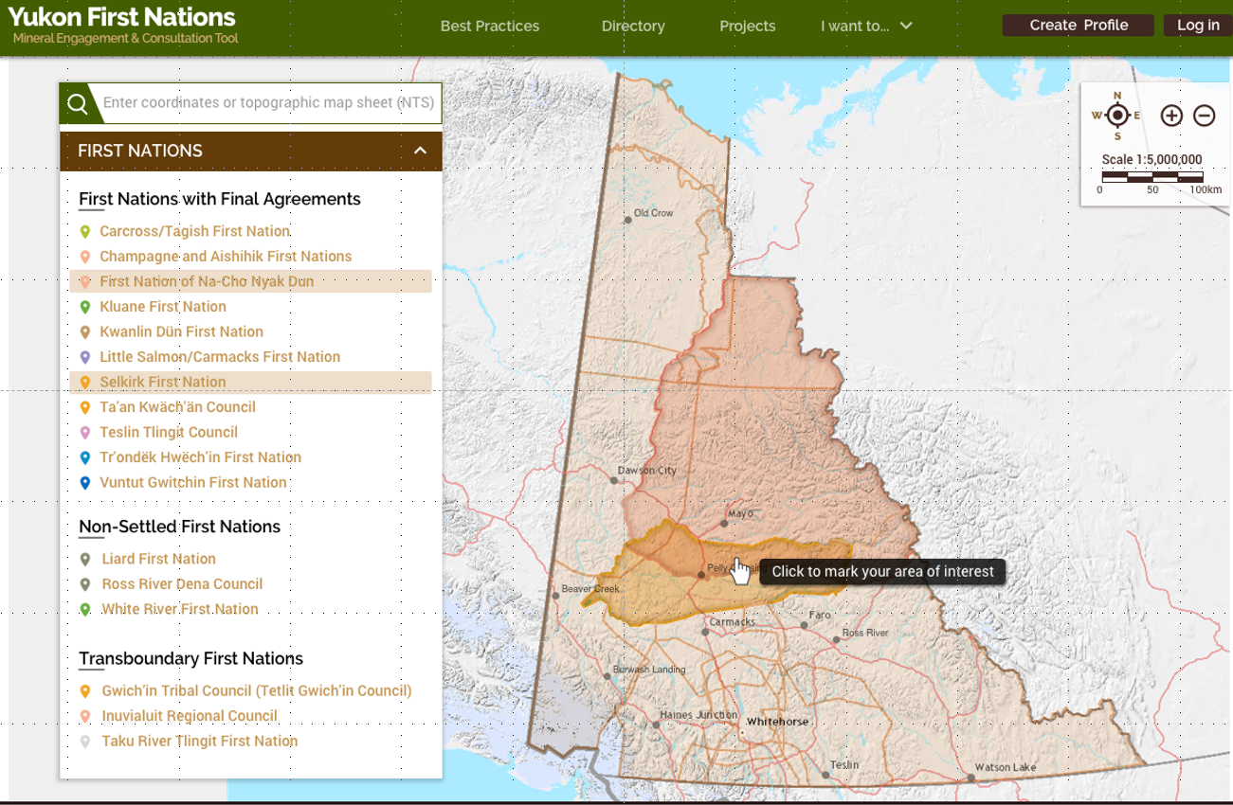
The Look…
www.archbouldphotography.com
PDAC
March 6, 2018
Notes:
SUE

Slide 14
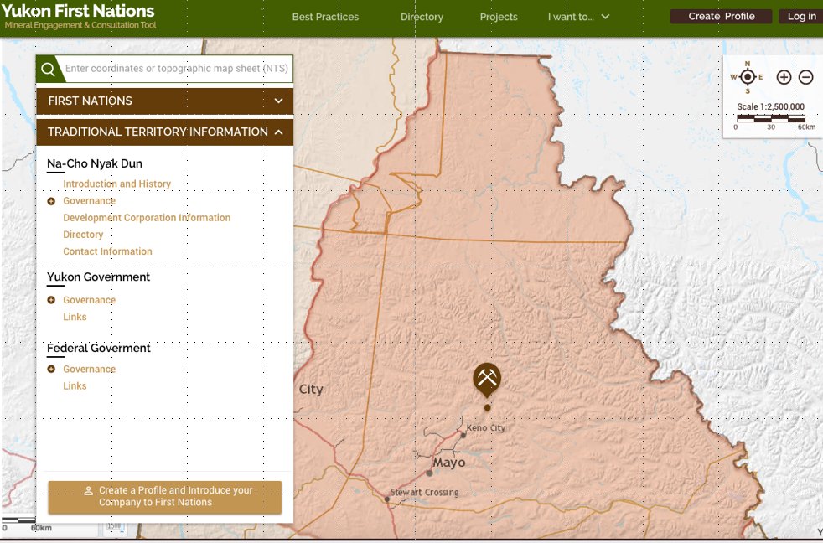
The Look…
www.archbouldphotography.com
PDAC
March 6, 2018
Notes:
SUE

Slide 15
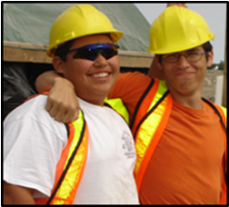
Proponent Self Identification Process
Provides an opportunity to reach out to a First Nation before a project is designed.
“Profile Form” is filled out by the Proponent and then automatically emailed to appropriate First Nation contact.
The web site is a map driven process, based on Traditional Territories.
Challenges:
First Nation personnel resources to respond, track and manage process.
www.archbouldphotography.com
PDAC
March 6, 2018
Notes:
SUE

Slide 16
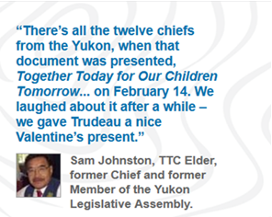
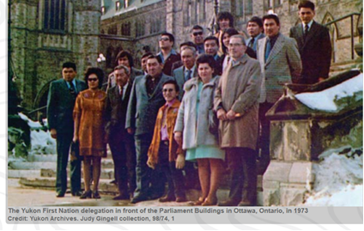
Yukon Land Claims History: Together Today for Our Children Tomorrow*
In 1973, Elijah Smith led a delegation of Yukon First Nation leaders to present, “Together Today for our Children Tomorrow”, to the Prime Minister of Canada. This document petitioned the Government of Canada to negotiate land claims with Yukon First Nations.
PDAC
March 6, 2018
*mappingthe way.ca
Notes:
JUDY – BACKGROUND DURING HER SPEECH

Slide 17
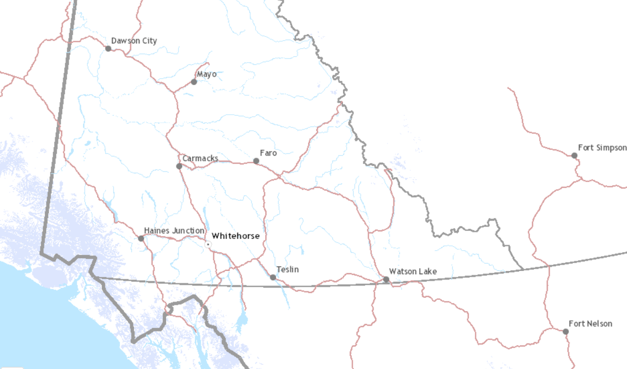
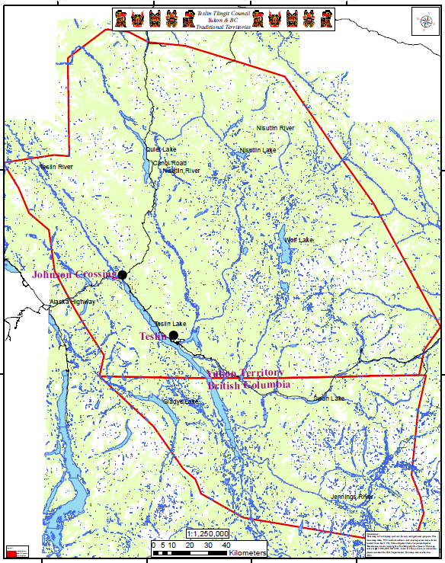
First Nations Involvement
Yukon First Nation Engagement and Consultation Guide will help us do our jobs as Self-governing First Nations.
The Guide gives the exploration industry useful information about the Teslin Tlingit Traditional Territory and our expectations for engagement and consultation.
Whitehorse
Teslin
www.archbouldphotography.com
PDAC
March 6, 2018
Notes:
EMMIE

Slide 18
First Nations Involvement
Teslin Tlingit Council Final Agreement (1993) resulted in:
1230.24 sq km of Category A Settlement Lands (surface and subsurface).
1165.49 sq km of Category B Settlement Lands (surface) and Fee Simple Lands.
This means that the Teslin Tlingit Council has a vested interest in the mineral exploration industry.
The Guide will also provide the following information:
our Mining Policy (under review).
the Teslin Tlingit Council First Nation Self-Government Agreement that sets out our structure of government.
the Settlement Land and Resources Act for Tlingit lands.
In short, the Guide is a single reference point to access all of this critical information.
www.archbouldphotography.com
PDAC
March 6, 2018
Notes:
EMMIE

Slide 19
First Nations Involvement
We are strong supporters of responsible stewardship of land and resources, and we believe this Guide can help us educate and work with the exploration industry so that we all benefit.
We share with Yukon and Canada, the management of all of our Traditional Territory, and for that reason the industry should consider us as much a partner as it does public governments.
We are a Government, and this is often not understood or appreciated.
The Guide will be a useful tool to build awareness of the Yukon context where we share its management and its successes.
www.archbouldphotography.com
PDAC
March 6, 2018
Notes:
EMMIE

Slide 20
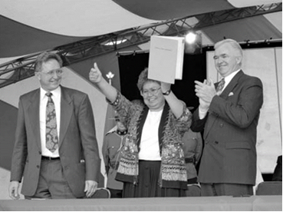
Next Steps
By Month End:
Complete website and upload information.
Complete Mobile Application.
Complete Hard Copy Engagement and Consultation Guide.
Continued Technical Support for Website and Mobile Application.
www.archbouldphotography.com
Yukon’s Umbrella Final Agreement, 1993
PDAC
March 6, 2018
Notes:
SUE

Slide 21
In Summary
Working in partnership on this Guide will provide a central location for integrated web based information on First Nations engagement and consultation Best Practices with unique features such as a Proponent Self Identification Process.
This Guide should be a benefit to First Nations, the mineral exploration industry and Yukon residents at large.
The key to effective engagement and consultation is the building of partnerships that are based on long term “clear and consistent communications, trust, respect and carefully listening with an open mind”.
www.archbouldphotography.com
PDAC
March 6, 2018
Notes:
STEVE

Slide 22
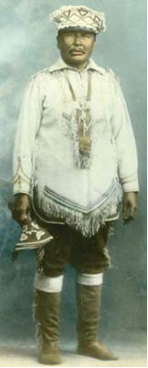
In Closing
A big thank you to the Prospectors and Developers Association of Canada for putting on this Panel!
www.archbouldphotography.com
PDAC
March 6, 2018
Notes:
STEVE

