Slide 1
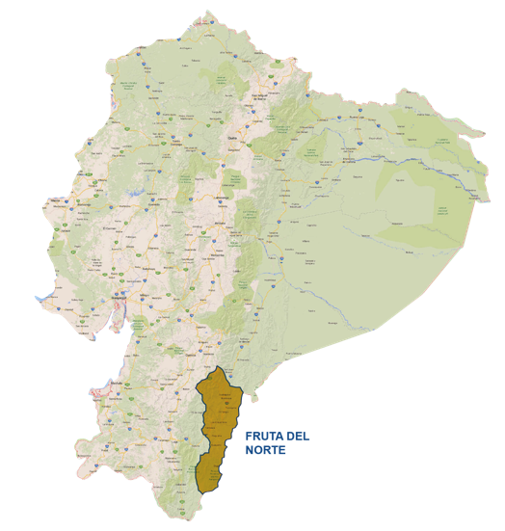
FRUTA DEL NORTE
Southeast Ecuador
The nearest city to the Fruta del Norte Project area is Loja, the fourth-largest city in Ecuador.

Slide 2
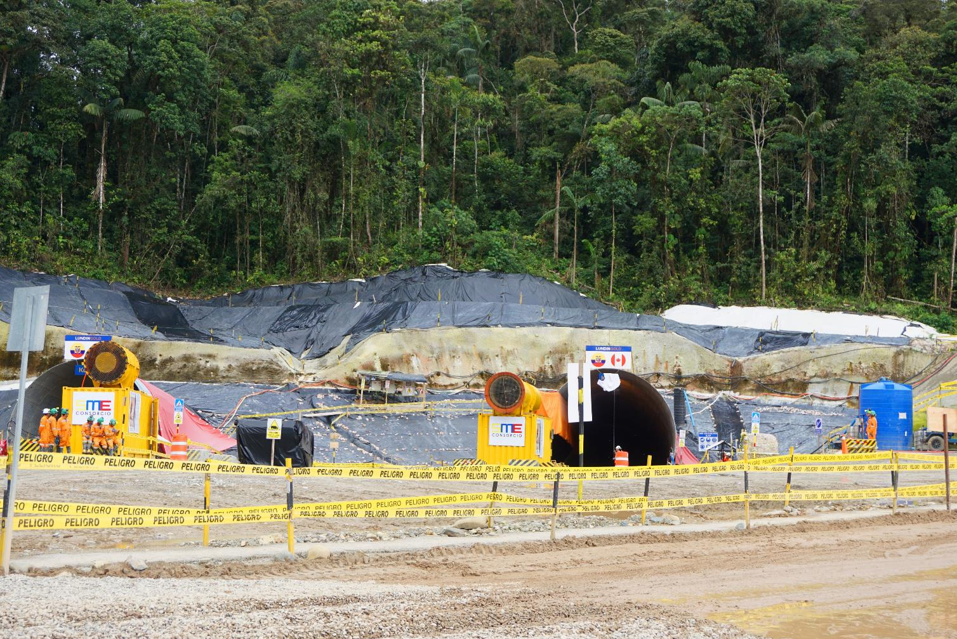
Start of the K’isa and Kuri twin declines

Slide 3
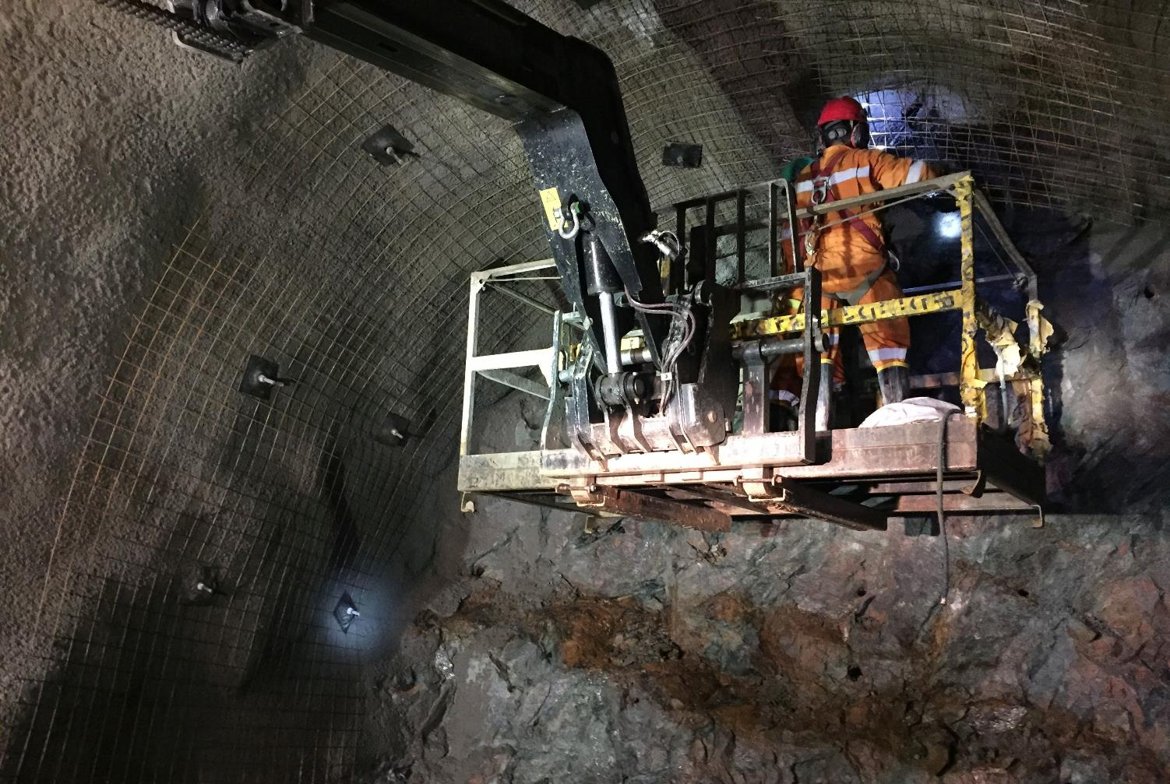
Into hard rock in Kuri and K’isa - underground mine development is now proceeding at a quicker pace

Slide 4
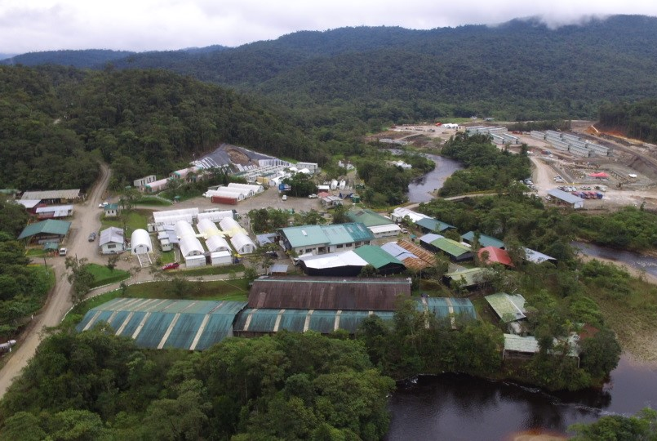
Las Peñas camp and construction camp in the background

