Slide 1
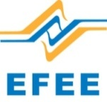
Canadian and international experiences
PDAC 2019
Hans Hinrichsen, General Manager, Greenland School of Minerals & Petroleum

Slide 2
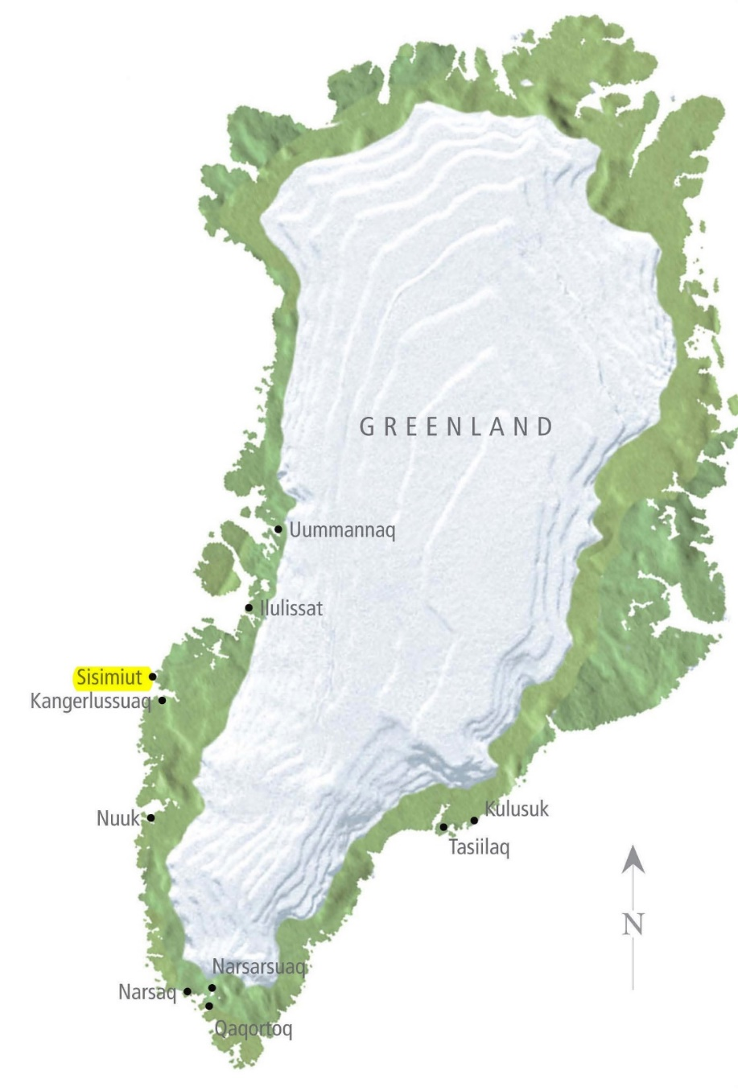
Greenland Facts
Country
GEOGRAPHY
The world’s largest island
Total area 2,166,086 km2
Inland ice & glaciers 1,755,637 km2 (81%)
Coast line totals 44,087 kilometers
1 km2 of forest
GOVERNMENT
Greenland is an autonomous constituent country
-within the Kingdom of Denmark
Naalakkersuisut is Greenland’s government
- elected by Inatsisartut, Greenland's legislative assembly
SOURCES OF INCOME
Sealing and whaling, fishing & hunting, tourism, mining

Slide 3
Greenland Facts
Country
LANGUAGE
Greenlandic (Kalaallisut), Danish, English (mining)
POPULATION
Population: 55.877 people living in Greenland
89.2% born in Greenland, 10.8% born outside Greenland
FOREIGN NATIONALITIES LIVING IN GREENLAND
Iceland (204), Thailand (175), Philippines (162), Sweden (98),
Norway (62), Germany (50), USA (41), other (265)
DENMARK
Approx. 15.000 Greenlanders live in Denmark

Slide 4
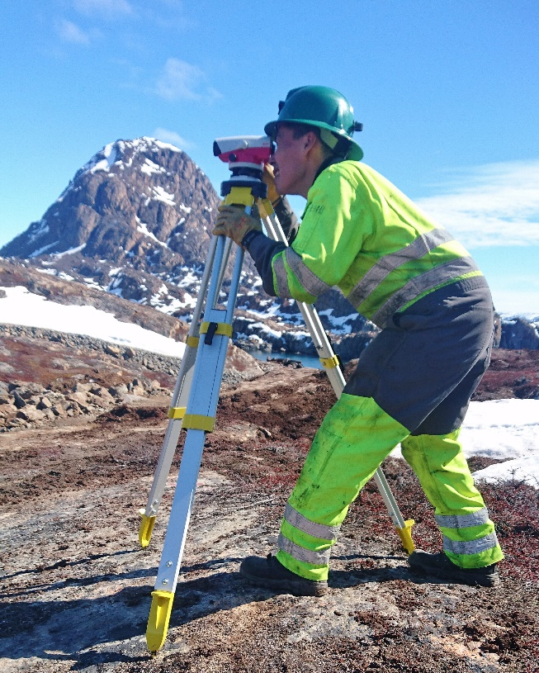
Greenland Facts
Workforce
WORKFORCE
Approx. 26,844 between 18-64 years of age
Unemployed per January 2018: 3.308
15.245 with Primary School Education (56.4%)
6.679 Vocational Education (24.7%)
3.773 Higher Education (14%)
1.186 High School
MATCH GROUPS
Match Group 1
Ready to take a regular job 1.712
Match Group 2
Limitations in the ability to work, will need upgrading of competencies 941
Match Group 3
Can not receive employment-oriented offers, must receive support, treatment, etc. 83

Slide 5
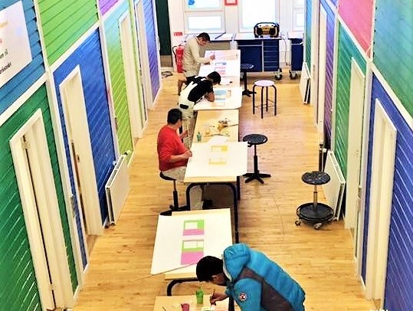
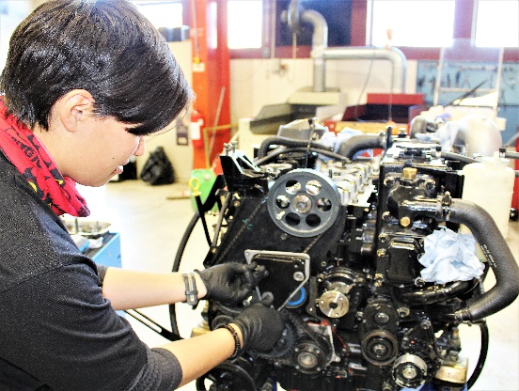
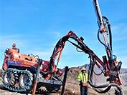
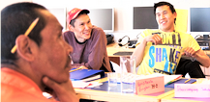
Teknikimik Ilinniarfik – Tech College Greenland (KTI) Sisimiut & Nuuk, Greenland
Greenland School of Minerals & Petroleum
KTI GUX Sisimiut
Carpenters & Painters
Building & Construction School
Language Courses

Slide 6
Our Mission:
”To educate & prepare Greenlanders for work in the construction-
and mining industry of the future Greenland”
2008 Started as “Bjergværksskolen” (School of Mountain Work)
- At the KTI Building & Construction School
2010 Inauguration of a new school building
Mining- & Entrepreneur School name change to “Råstofskolen” and its English name:
Greenland School of Minerals & Petroleum
- On- & offshore education activities
2012 Apprenticeship programs added
2013 Nunavut collaboration established
2014 Future planning: courses, equipment, facilities
2015 & Launching of Industry Specific Courses
2016 “Rigging & Lifting” (construction work, mining, airports, harbors, etc.)
”Basic Laboratory Technician” (TNG Ruby Mine)
2016 Nunavut Arctic College/KTI Memorandum of Understanding (MOU)
2016 The School’s first apprentices graduated in June 2016 (Journeymen’s Certificates)
2017 Nunavut Arctic College visit/KTI Building & Construction: Teema Palluq & Kevin Killiktee

Slide 7
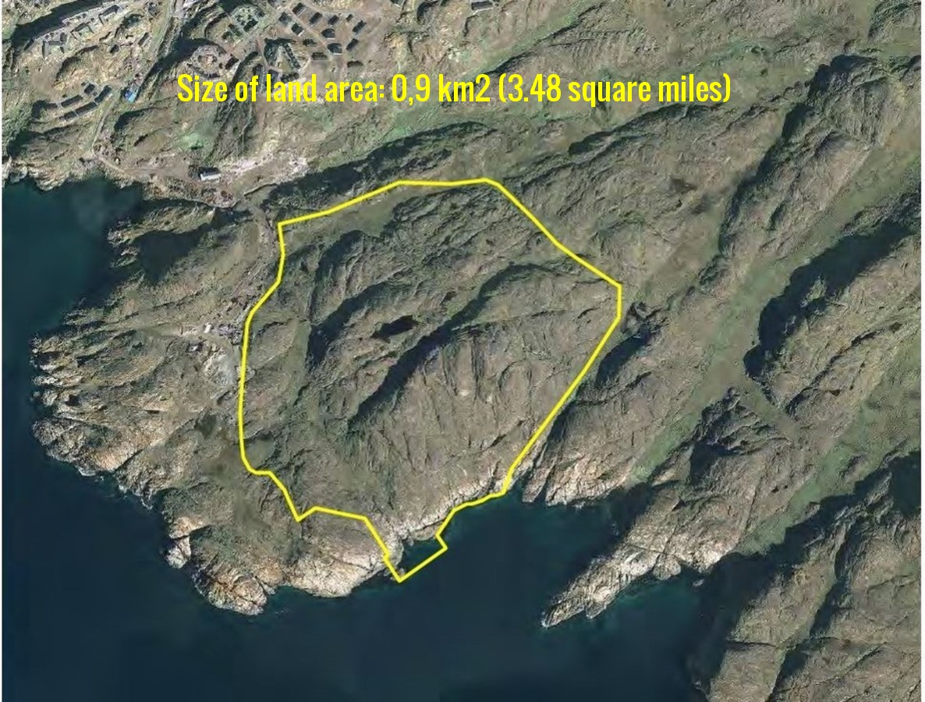
Mining & Constuction Skills Training Area

Slide 8
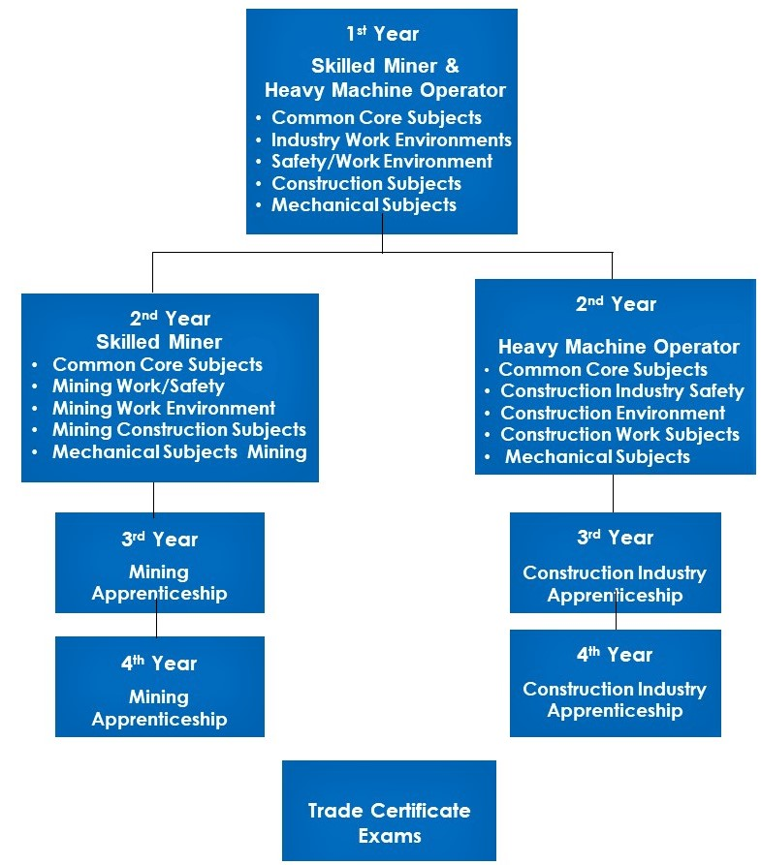
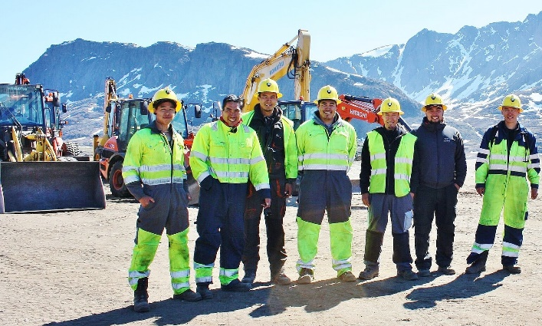
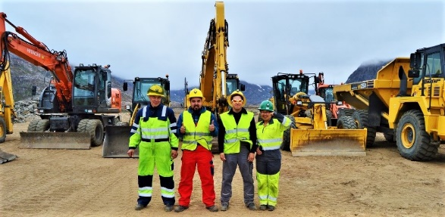
Current Education
Journeymen Certificates

Slide 9
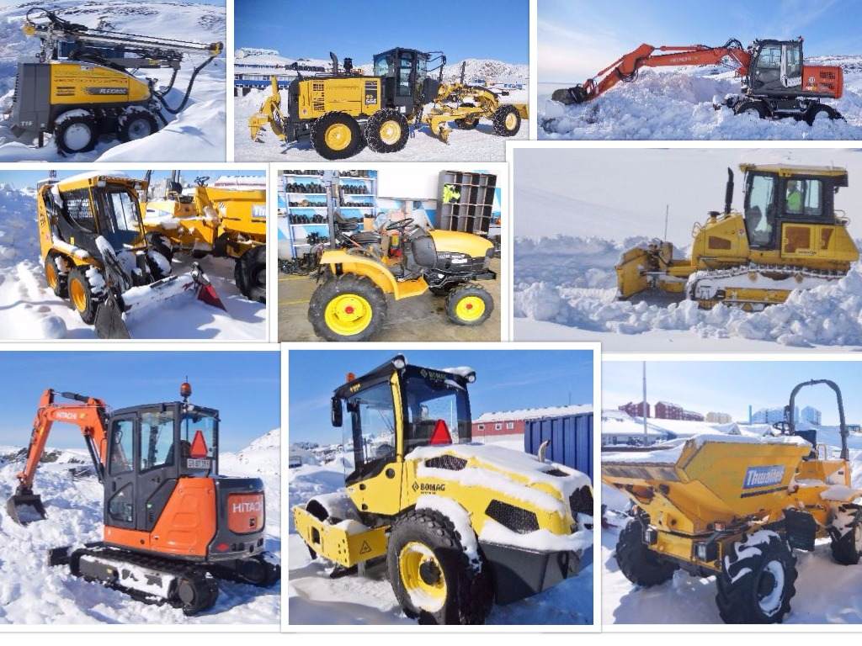
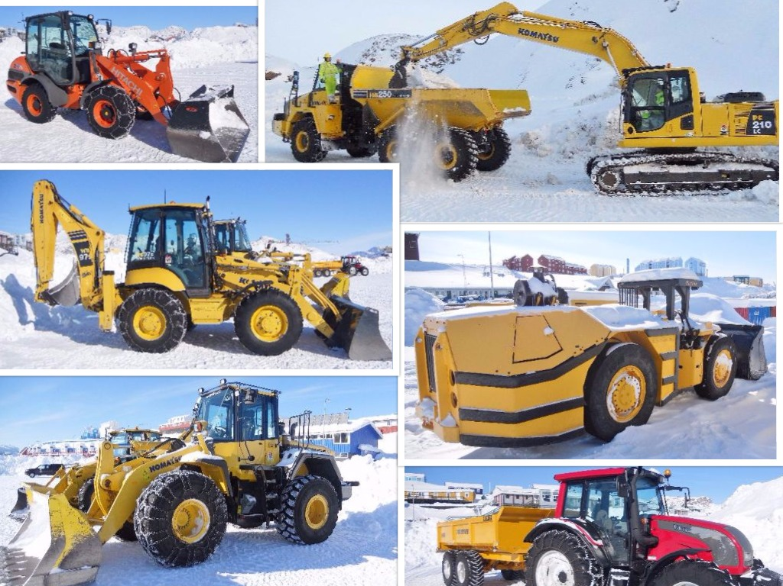
Heavy Equipment

Slide 10
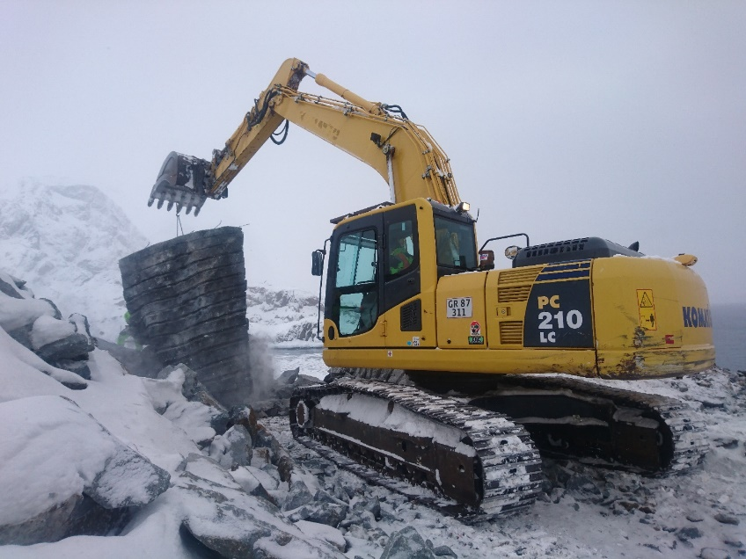
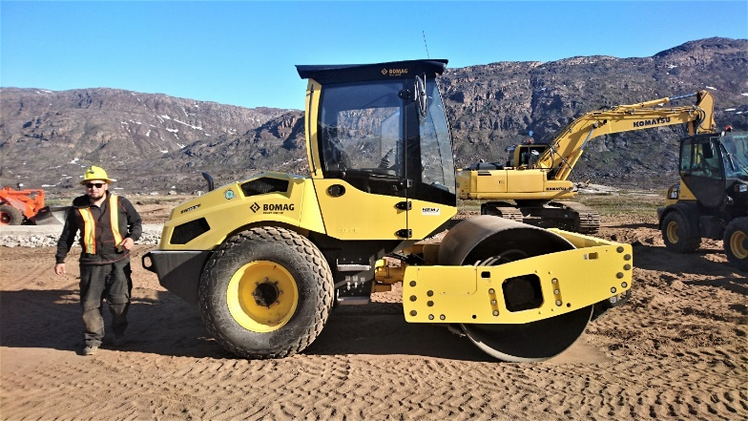
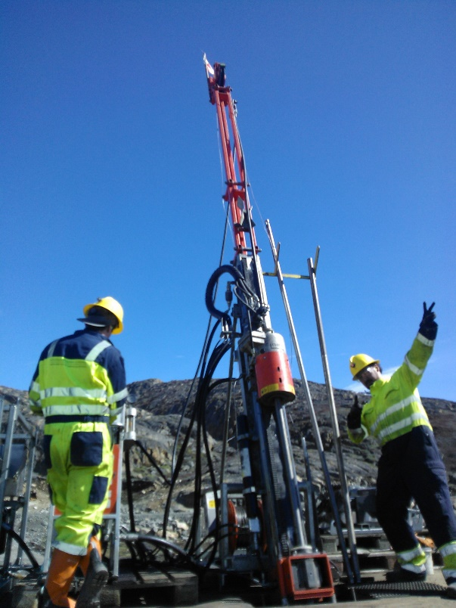
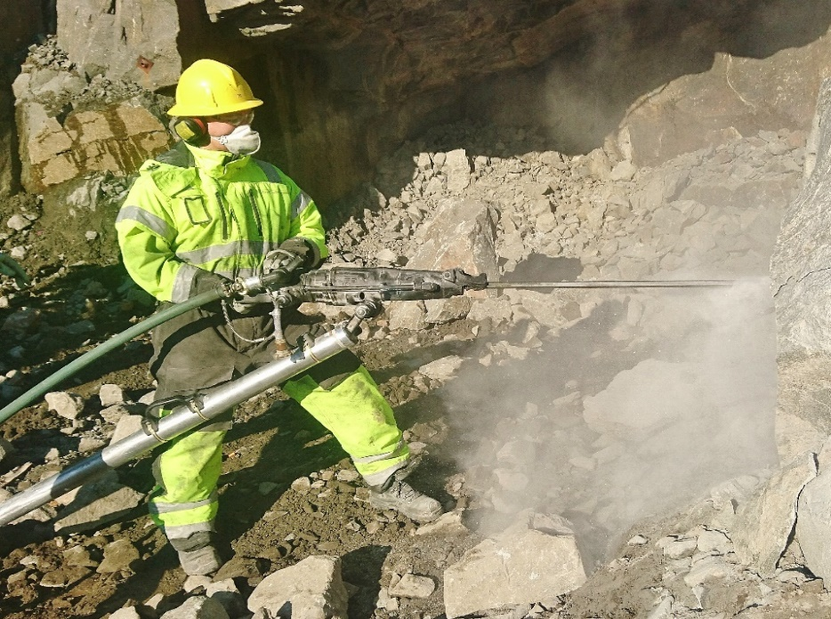
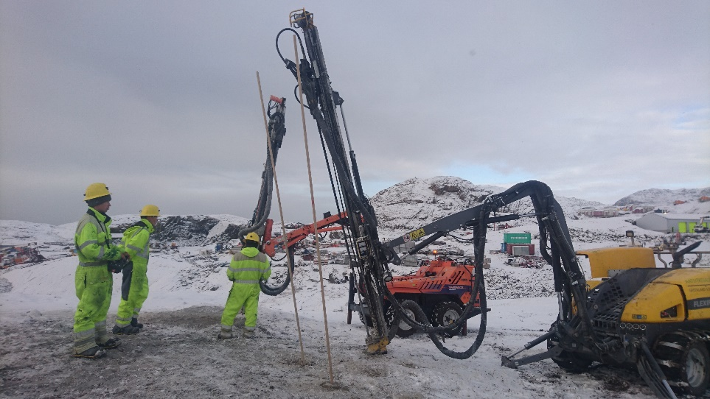
Heavy Equipment

Slide 11
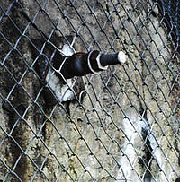
Education Development
Under Development
Safety Certificate, heavy equipment conductors (municipalities, companies)
Underground Search & Rescue Program
Tunnel Blasting
Rock Bolting & Shot Crete
Simulator Technology for Heavy Equipment
Drone Technology
Stone Crushing and Stone Sorting
Snow Removal
Further Developments at Tech College Greenland
Education as “Chief Machine Engineer”
Supplementary courses for various trade groups, i.e. electricians
Heavy Equipment Mechanic

Slide 12
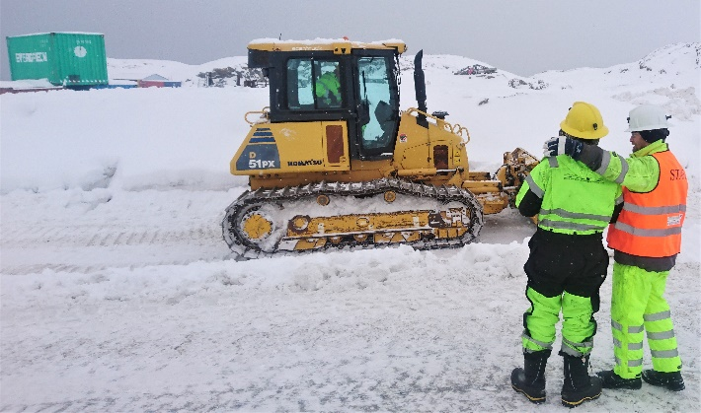
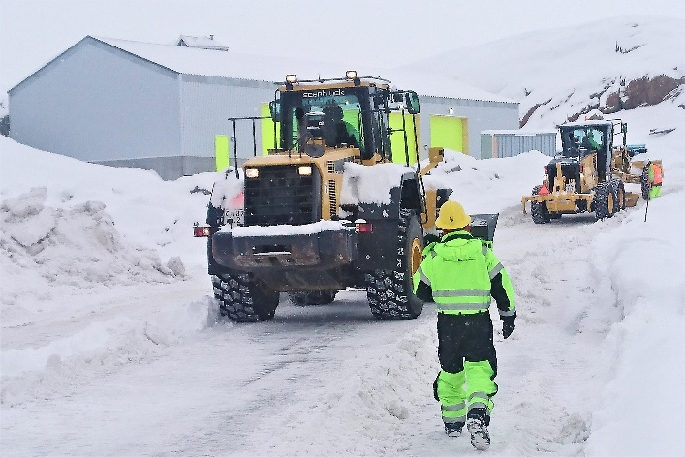
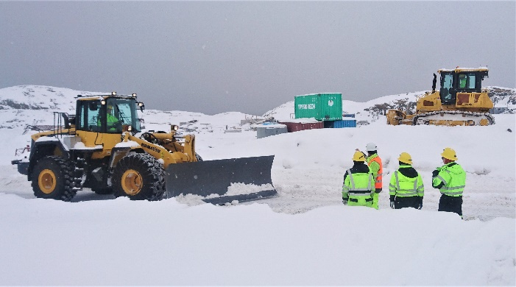
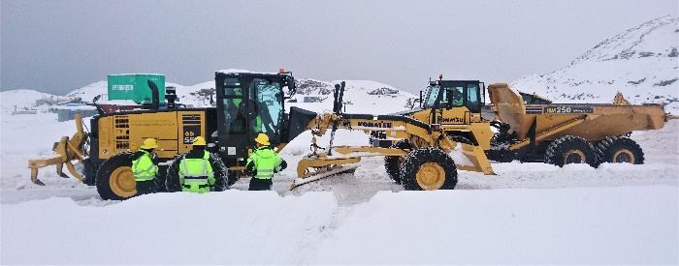
Current Courses
Heavy Machine Operator & Snow Removal
Heavy machine operator (international certification)
4 weeks training on:
Front wheel loader Komatsu NA380-6
Front wheel loader Hitachi ZW75
Excavator Komatsu PC210LC-8
Excavator Hitachi ZAXIS 140W-3
Dozer Komatsu D51 PX22
Backhoe Komatsu WB975-5EO
Grader Komatsu GD555-5
Dump truck Komatsu HM250-2
Urban Snow Removal
1 week training (only for experienced machine operators)
Safety training, planning, plowed snow & storage
Maintenance and practice with snow removal equipment.

Slide 13
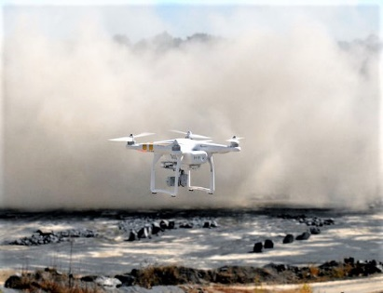
Current & Future Courses
Certified Shotfirer Blasthole Drill Operator
3D Blast Modeling Vibration Measurement
Certified Shotfirer (theory)
2 weeks training
Greenlandic explosives regulations, safety and practice
Must document one year’s blasting work with a licensed shotfirer
Then apply for a personal license –to be renewed every 5th year
Blasthole Drill Operator
3 weeks training:
Surface drill rig Atlas Copco T15
Surface drill rig Tamrock Commando 120R
3D Blast Modeling
2 weeks training:
Drone DJI Inspire 2
Drone DJI Phantom 4
Computers High level performance computers
System - 3GSM Blast Metrix UAV
Vibration Measurement
1 week training:
SigiCom Infra Master 4100
SigiCom V12 Triaviell Geophone
SigiComS10 Air Blast Microphone

Slide 14
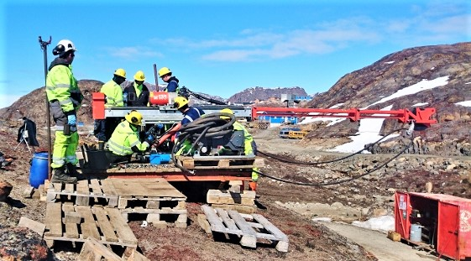
Current and Future Courses
Diamond Core Drilling Stone Crushing & Screening Rigging & Lifting
Diamond Core Drilling
6 weeks training:
Core Drill rig Sandvik DE130
Core Drill rig Atlas Copco Diamec 252
Stone Crushing & Screening
2 weeks training on:
Crusher Sandvik mobile crusher QJ 271
Screener Sandvik mobile screener QA 331
Rigging and Lifting
2 weeks training with:
Special designed rigging container for confined spaces
+ relevant equipment
Lifting 2 gantry crane 5m 2T

Slide 15
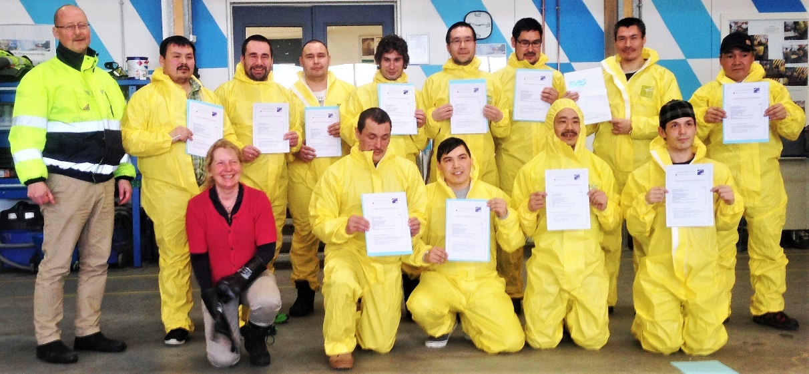
Current and Future Courses
Basic Laboratory Safety Courses Under Development
Introduction to Basic Laboratory Safety Procedures
2 weeks
Working in a safe manner under supervision in a laboratory
Basic laboratory procedures
Personal conduct and responsibility, basic laws and regulations
Laboratory safety rules and safety equipment
Handling of laboratory accidents, dangerous waste handling
Courses Under development:
Certified mine safety for new miners (similar to NORCAT practice)
Technical English and mining terminology

Slide 16
Course Funding Structure
PKU: Development of Work Competencies Project
Ministry of Industry, Labour, Trade and Energy:
PKU: Development of Work Competencies for Unskilled Labour
Course Requirements & Regulations:
You must be unskilled and over 25 years of age
Travel, room and board, course fees and materials are covered by PKU
Participants receives a weekly course salary from PKU (696 CAD per week, taxable)
All trade institutions (7 schools total) can apply may apply for annual PKU course funding
(Total annual PKU budget CAD 4.750.000)
G.S.M.P. average annual grant: CAD 1.988.000
Supplementary equipment grant in 2017: CAD 1.188.500
Ministry of Education, Culture, Research and Church
AMA: Employment Market Contribution
Course Requirements & Regulations:
AMA (Employment Market Contribution) – employer fee paid to the Department of Education
Travel, room and board are covered by the AMA – employers cover course fees and materials
Employers must pay normal salary during the course.
All trade institutions (7 schools total) can apply may apply for annual AMA course funding
(Total annual AMA budget CAD 3.868.000)
G.S.M.P. average annual grant: CAD 216.000

Slide 17
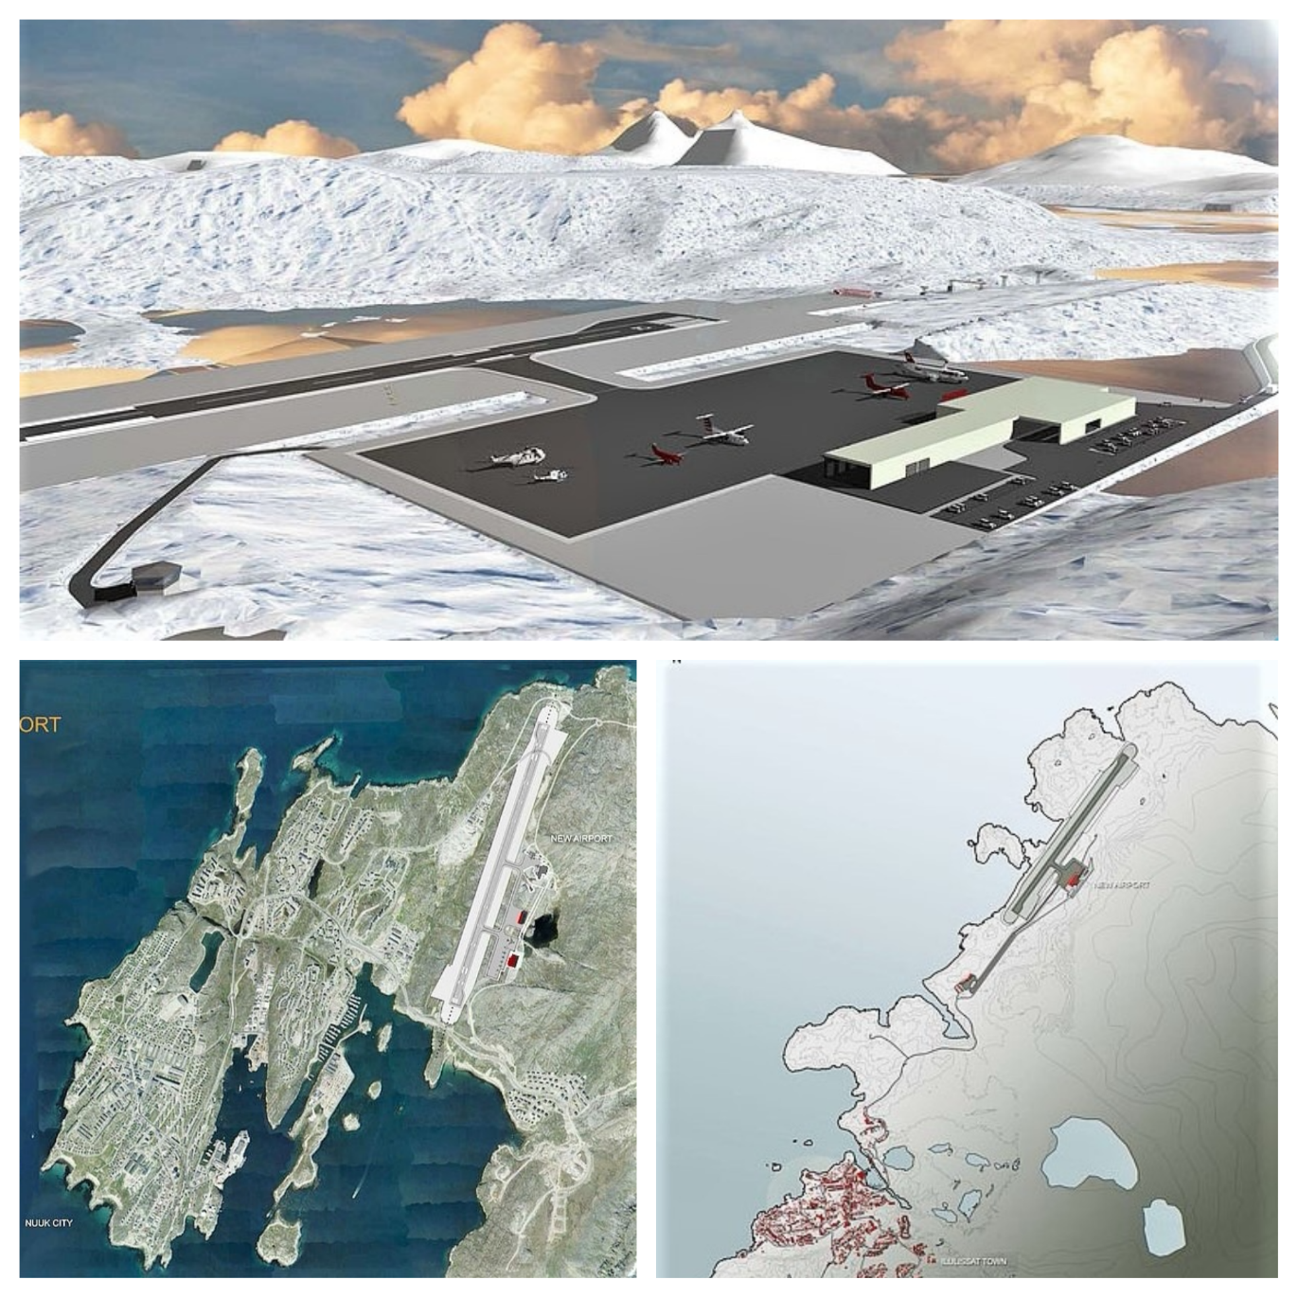
Kalaallit Airports A/S: Greenland: Planned Extended & New Airports
Kalaallit Airports A/S:
Founded by the Government of Greenland July 1st, 2016.
Aim: To build, own, operate airports in Nuuk, Ilulissat & Qaqortoq
Nuuk: Expand current landing strip to 2200 meters
Rebuild existing airport road.
Terrain regulation by rock blasting of 6 million m3 & burst refill
Ilulissat: Expand airport with new 2200 meters landing strip
Extend current airport road
Excavate permafrost layer beneath terminal- & airport strip
Terrain regulation by rock blasting of 6 million m3 & burst refill
Qaqortoq: Build new 1500 meters landing strip
Finish 7 kilometers of airport road
Terrain regulation by rock blasting of 2 million m3 & burst refill
Notes:
© Copyright Showeet.com – Free PowerPoint Templates

Slide 18
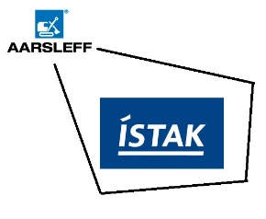
Kalaallit Airports A/S: Preselection: Potential Construction Companies
Upcoming Bids on Airport Construction:
Ilulissat, Nuuk & Qaqortoq
Kalaallit Airports A/S Prequalifies 6 Construction Companies
Aarsleff-Istak I/S Denmark/Iceland, joint venture
BAM International bv. Holland
China Communications Construction Company Ltd. China
Munck Gruppen a/s Denmark
MT Højgaard Denmark
Pennecon Dexter Canada, joint venture

Slide 19
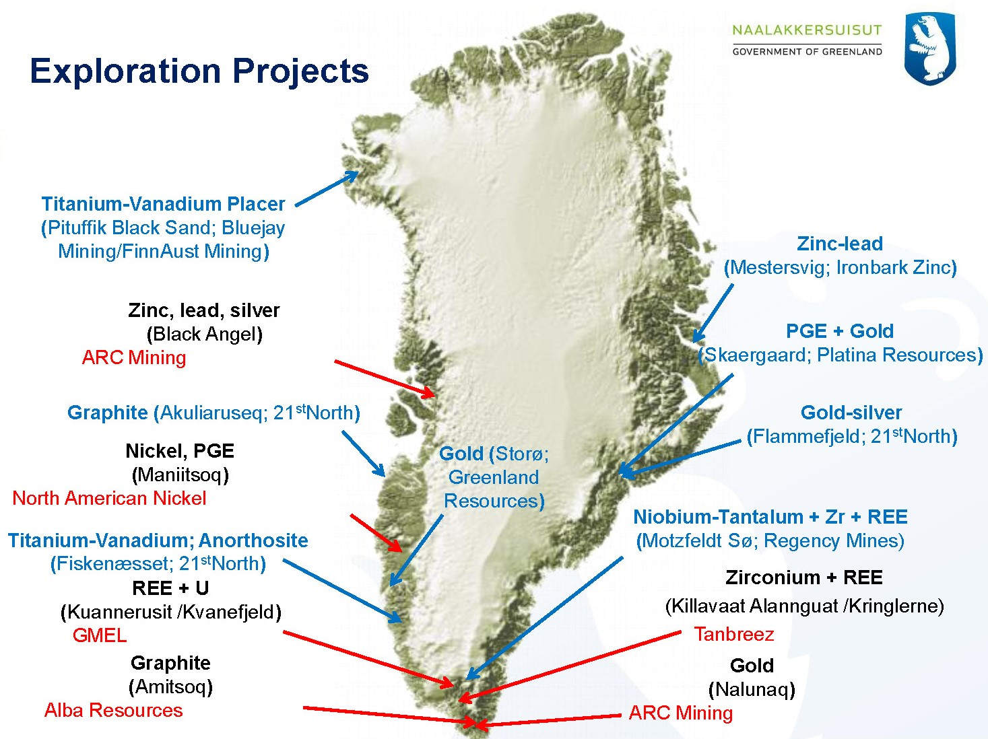
Greenlands Mining Opportunities
Current Exploration

Slide 20
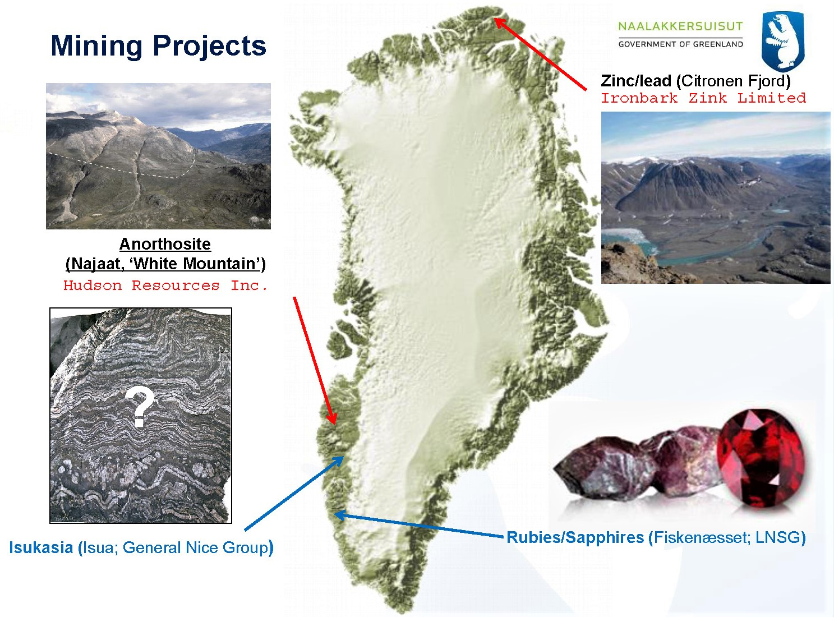
Greenlands Mining Opportunities
Active Mines & Projects

Slide 21
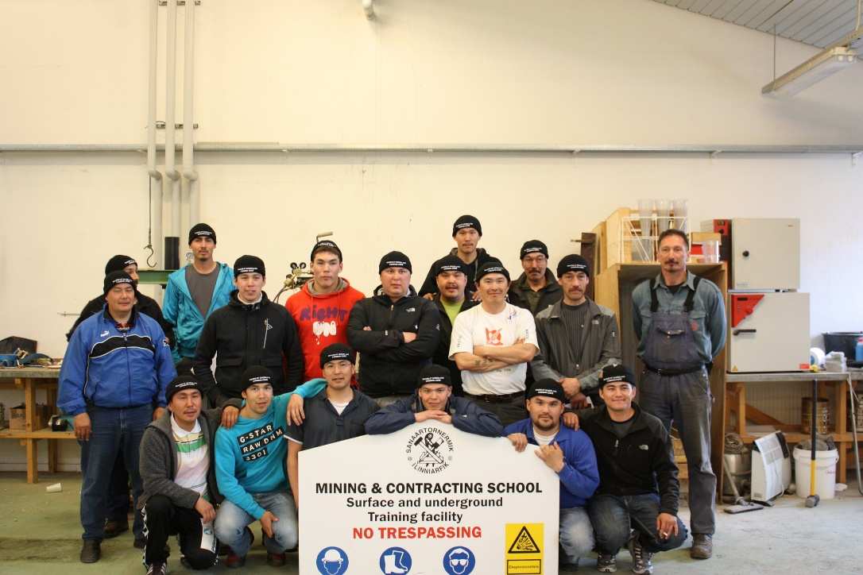
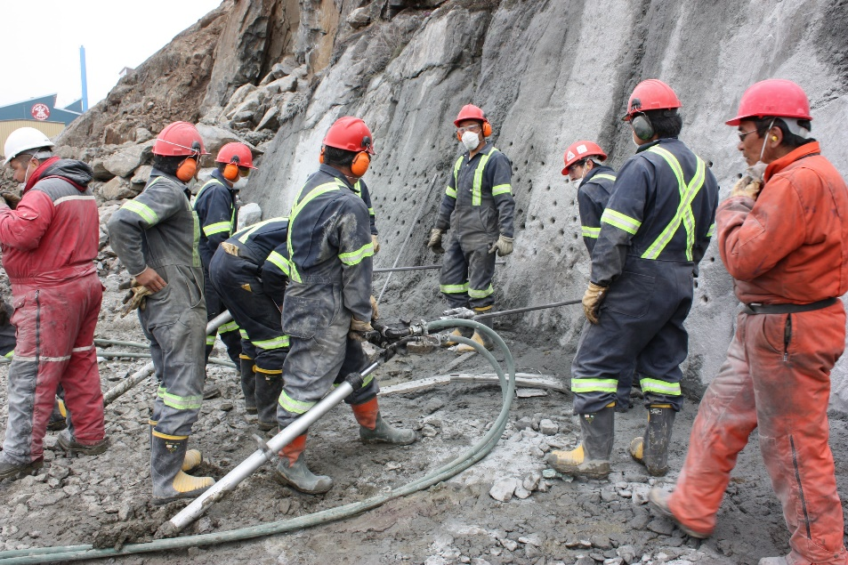
International Cooperation
2008 - Common Core for New Miners
MoU with Ole Vig Videregående Skole, Norway
Aid in start-up and upgrading of instructors for various courses in Greenland
NORCAT, Canada
Framework and inspiration for the Common Core for New Miners training program
Colorado School of Mines, USA
Provided instructors for the first Common Core for New Miners training program
Upgrading of staff for underground operations at Edgar Mine, Colorado
Notes:
© Copyright Showeet.com – Free PowerPoint Templates

Slide 22
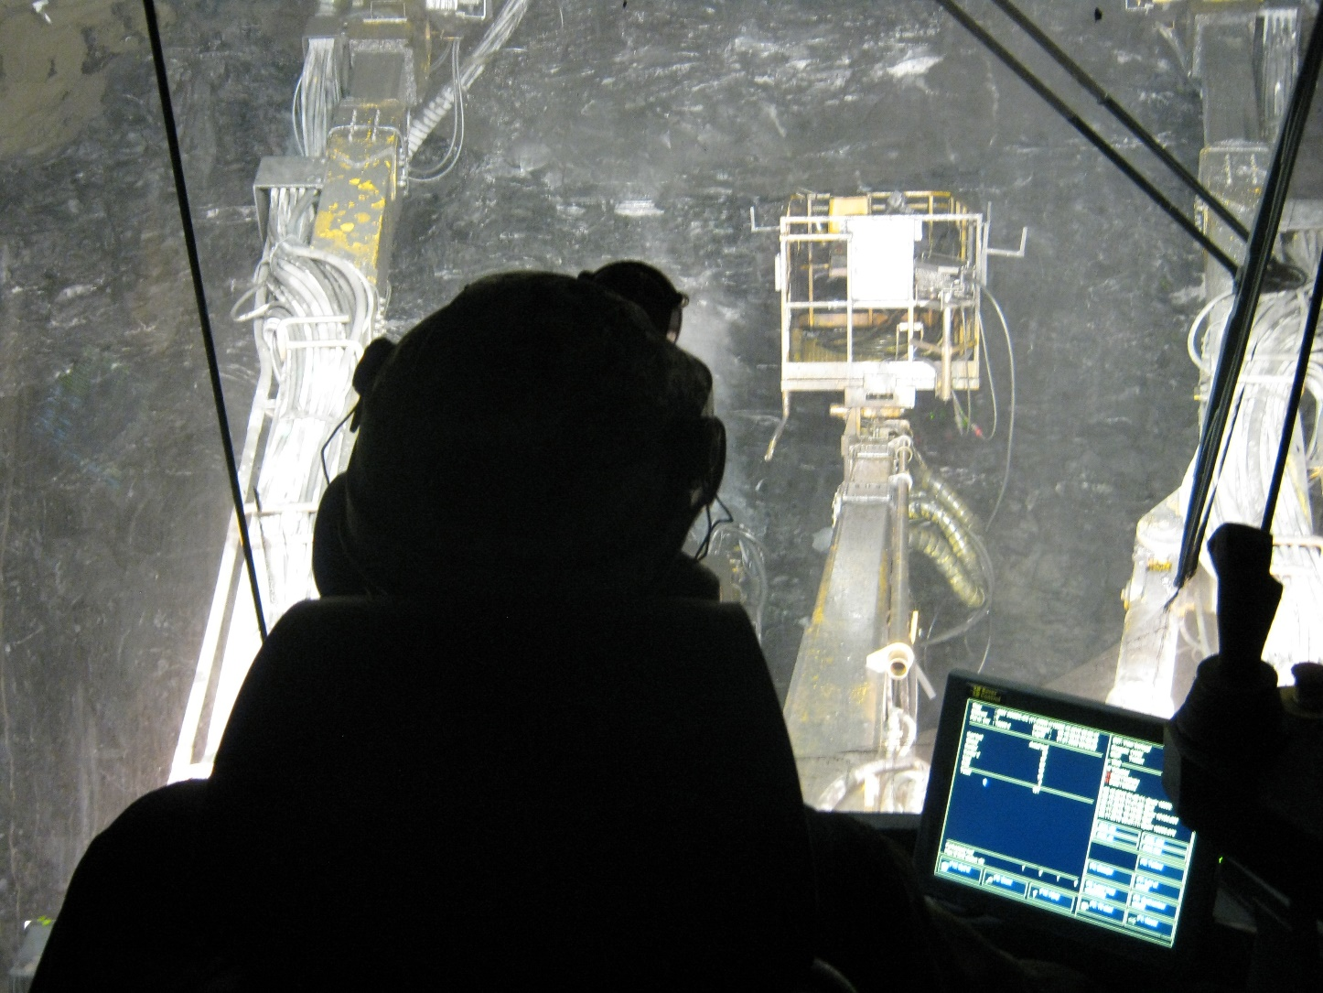
International Cooperation
2011 – Trade School Development
MoU with College of the North Atlantic, Newfoundland
Aid in development of safety courses
MoU with Kirkenes Videregående Skole, Norway
Framework and curriculum development for the Trade School apprenticeship program
Notes:
© Copyright Showeet.com – Free PowerPoint Templates

Slide 23
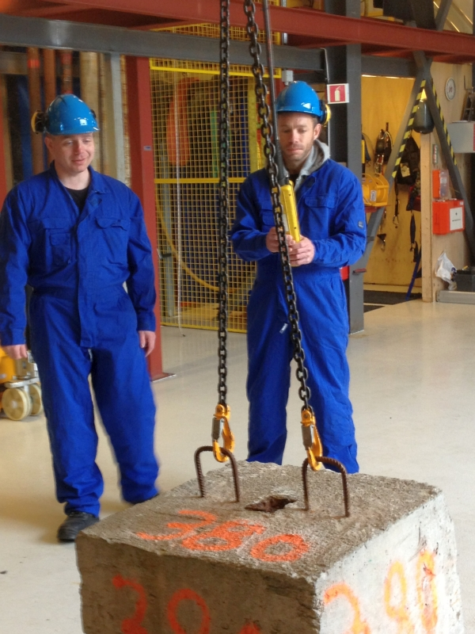
International Cooperation
2012 – FING Group (Faroe Islands, Iceland, Norway, Greenland)
MoU with the partner groups with the aim to provide standardized, quality training across the North Atlantic
Train the Trainer programs held within the countries of the partner group
Webinars regarding common subjects within the partner groups
Partner Schools:
Vinnuhaskulin Centre of Maritime Studies and Engineering, Faroe Islands
Akureyri Comprehensive College, Iceland
Stavanger Offshore Technical College, Norway
Greenland School of Minerals and Petroleum, Greenland
Notes:
© Copyright Showeet.com – Free PowerPoint Templates

Slide 24
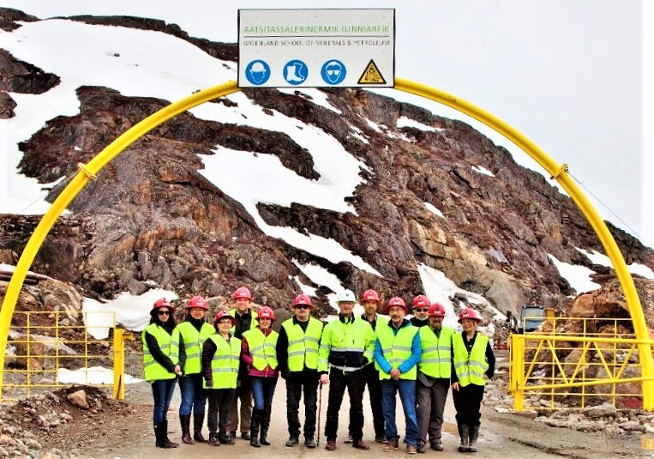
Nunavut Arctic College & Tech College Greenland Memorandum of Understanding – May 2016
Nunavut Delegation:
Honorable Paul Quassa
Eric Corneau
Qajaaq Elsworth
Jukeepa Hainnu
Stephanie Lachance
Sandy Napier
Elaine Uppahuak-Prusky
Elizabeth Ryan
Respective trade programs:
Sharing of information, experience,
expertise, staff & student exhanges
Notes:
© Copyright Showeet.com – Free PowerPoint Templates

Slide 25
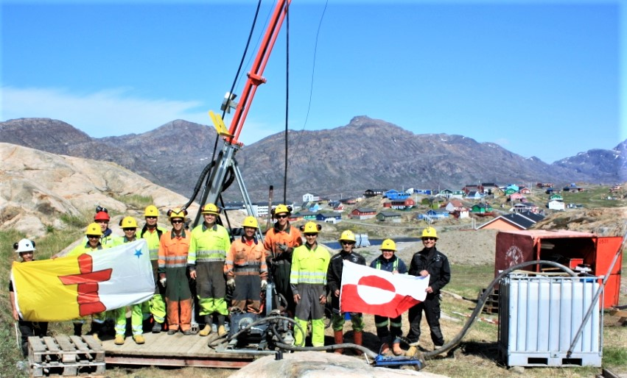
International Activities
Notes:
© Copyright Showeet.com – Free PowerPoint Templates

Slide 26
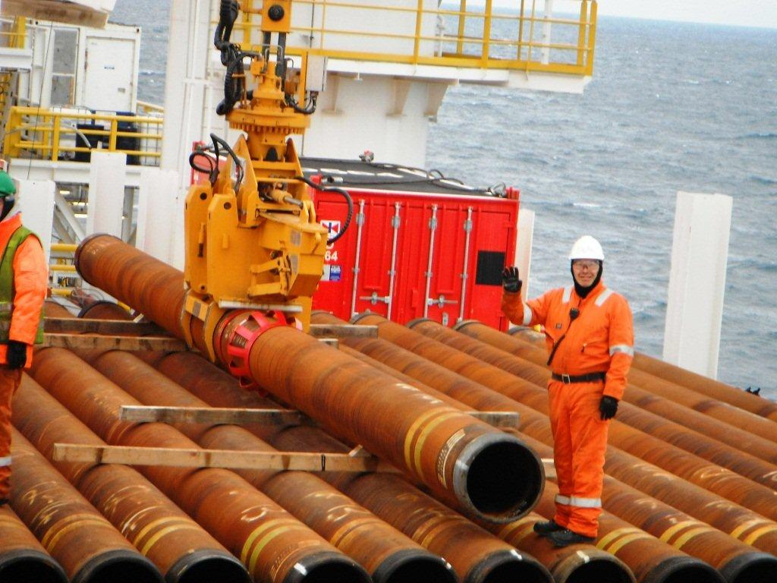
International Activities
2011 – Offshore
6 students from Greenland completed offshore safety and HUET training in Aberdeen, Scotland
Funded by Cairn Energy
All students hired by Cairn Energy as Roustabouts
Greenland School of Minerals and Petroleum
organized an international conferance in Sisimiut,
”Oil Exploration” to gather government and
industry interests. Over 200 in attendance.
Notes:
© Copyright Showeet.com – Free PowerPoint Templates

Slide 27
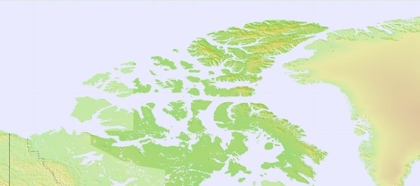
International Activities
2013 – Educational Exchange
Nathan Nakoolak & Patrick Murphy of Coral harbour participated in our Diamond Core Drilling program together with 10 Greenlandic students.
International Success:
Inuktitut and Kalaallisut (Greenlandic) are 2 languages of the North
After 2 weeks they were able to communicate with each other in their native languages
Nathan and Patrick felt they were amongst cousins and very much at home in Sisimiut
Both passed the final tests and were upgraded in their jobs to operate underground drills for Agnico Eagle in Nunavut.
Notes:
© Copyright Showeet.com – Free PowerPoint Templates

Slide 28
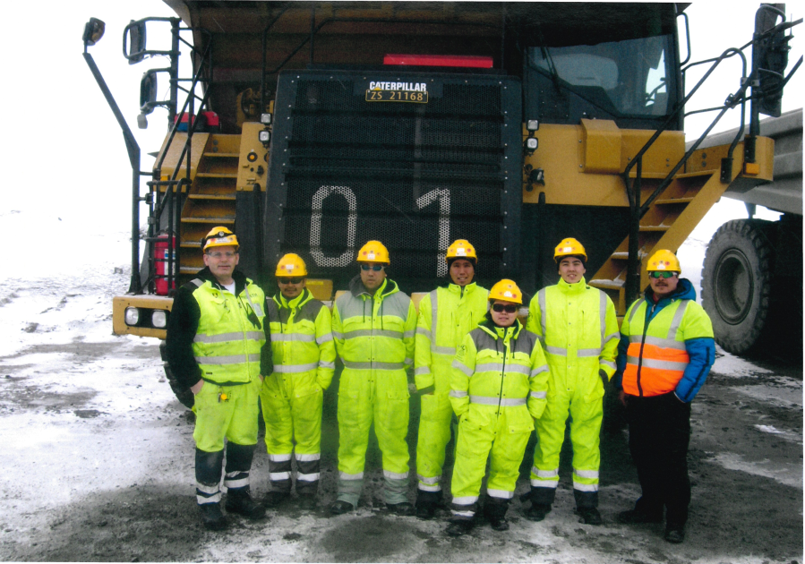
International Activities
2014 – Heavy Machines
6 students from Greenland trained on the Cat 777 haul trucks at Sydvaraner Gruve, Norway
Instructors from Kirkenes Videregående Skole
Notes:
© Copyright Showeet.com – Free PowerPoint Templates

Slide 29
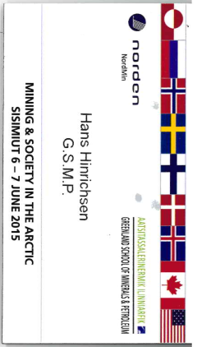
International Activities
2015 – International Conferance
Greenland School of Minerals and Petroleum arranged the international conferance ”Mining and Society in the Arctic”
Workshops focused on workforce mobility in the Arctic
Approx. 200 in attendance from all Arctic nations
Notes:
© Copyright Showeet.com – Free PowerPoint Templates

Slide 30
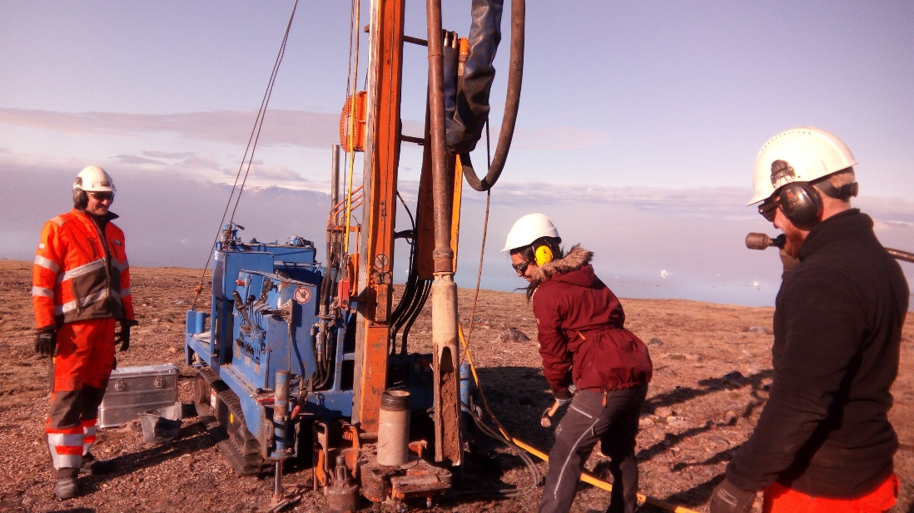
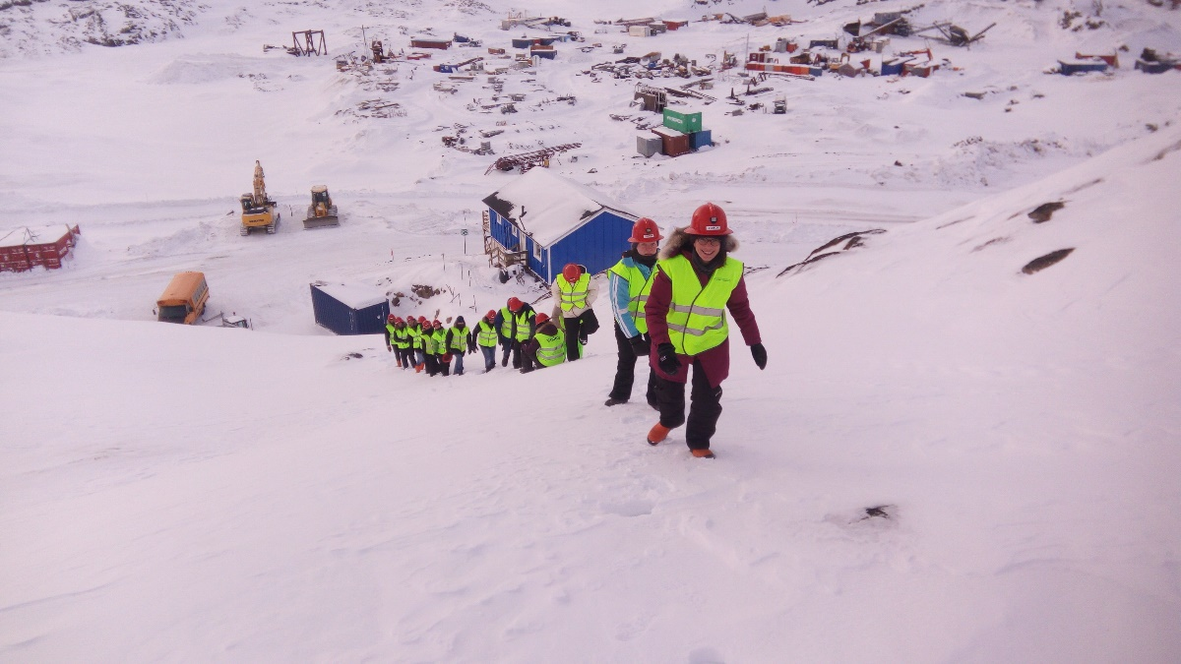
International Activities
2016 – Present – Arctic Semester
Collaboration with Technical University of Denmark (DTU)
Safety, Drilling and Blasting – Hands on training for MSc & BSc students from DTU and their partner universities:
University of British Columbia
Hong Kong University of Science and Technology
Budapest University of Technology and Economics
ETH Zurich, Switzerland
Notes:
© Copyright Showeet.com – Free PowerPoint Templates

Slide 31
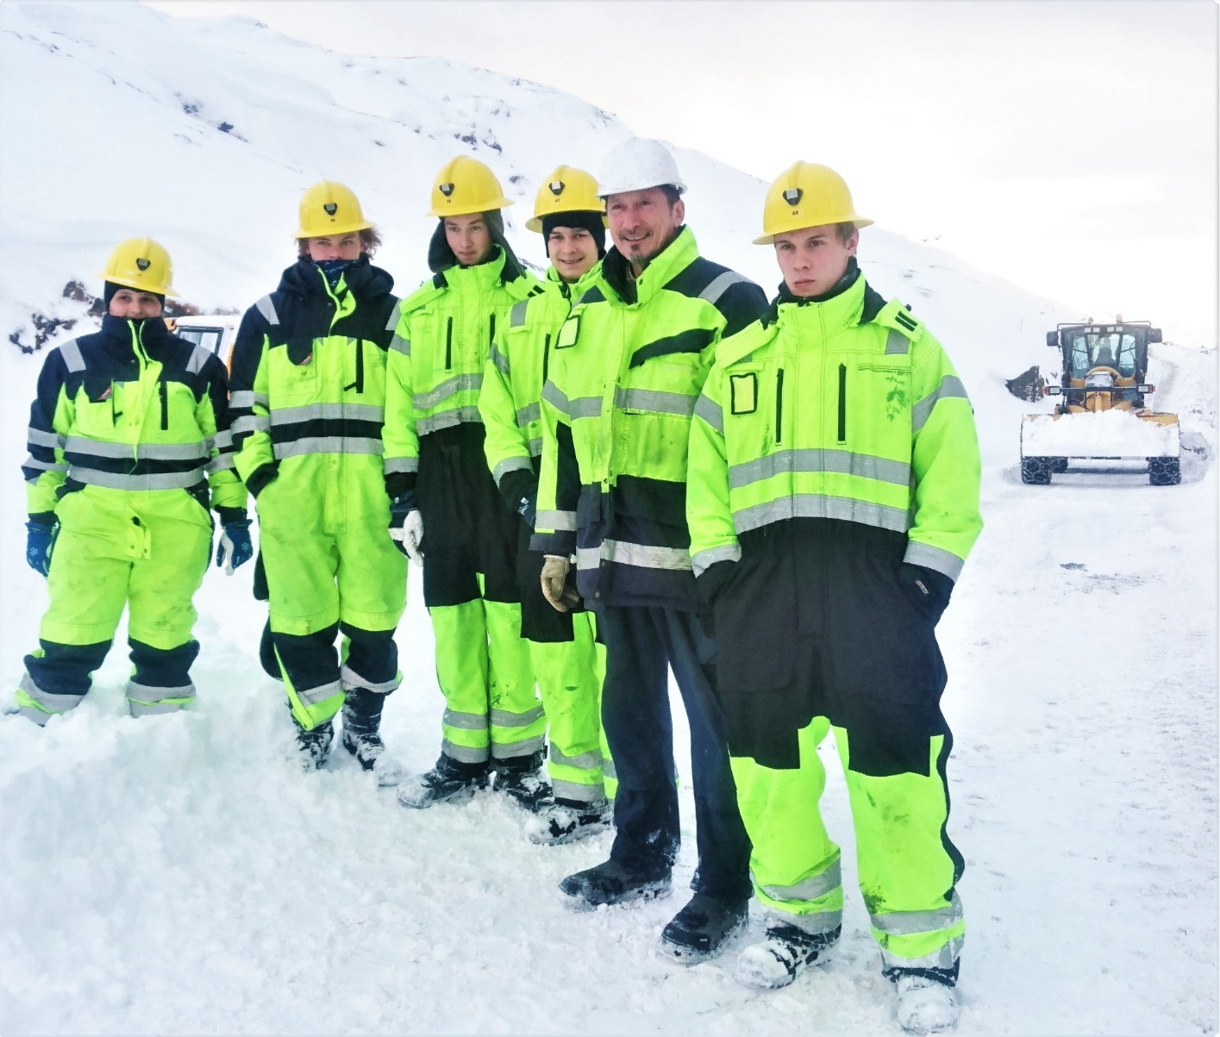
International Activities
2018 – Educational Exchange Ole Vig Videregående Skole, Norway
5 Norwegian students recieved 3 weeks practical training with heavy equipment in Sisimiut. All received ASAS certification for:
Front end loader
Bulldozer
Excavator
Back-hoe
Grader
Dump truck
An Instructor from Ole Vig taught our students land survey techniques. Our instructor provided training for the Norwegian students.
Notes:
© Copyright Showeet.com – Free PowerPoint Templates

Slide 32
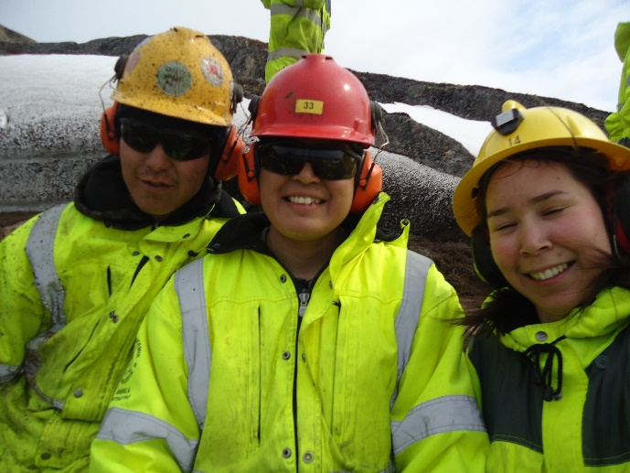
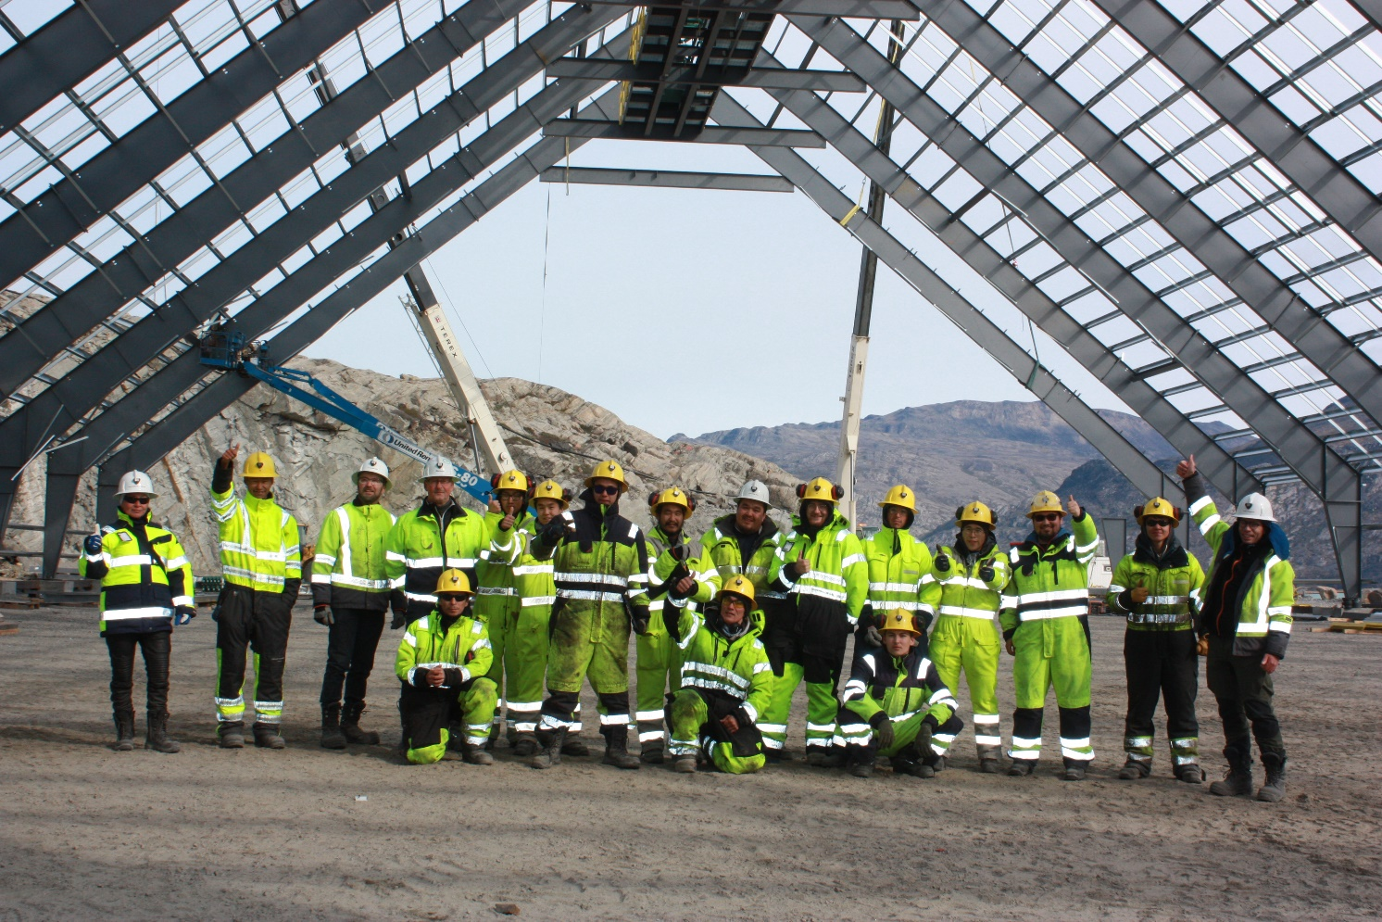
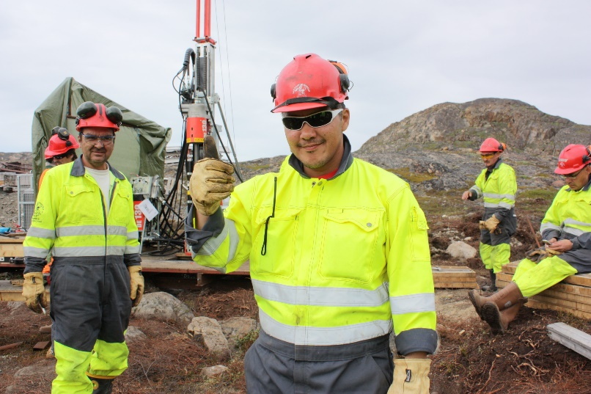
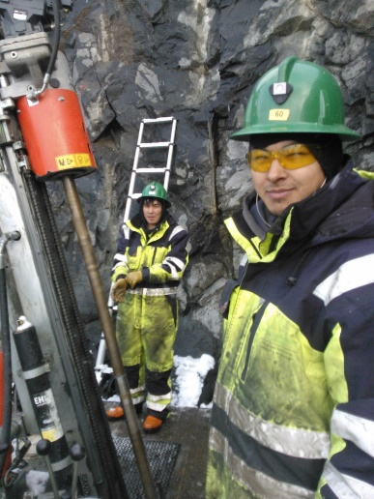
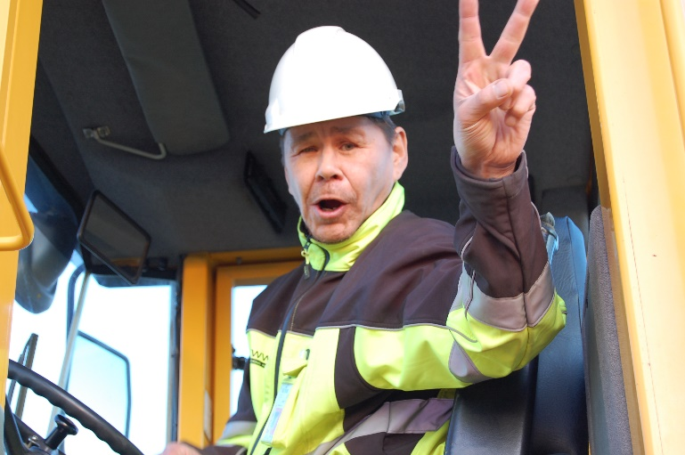
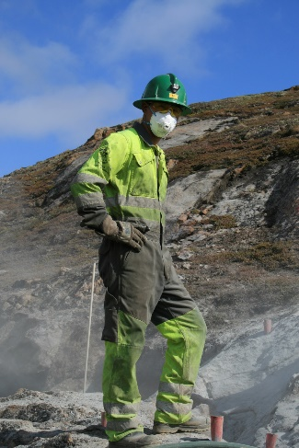
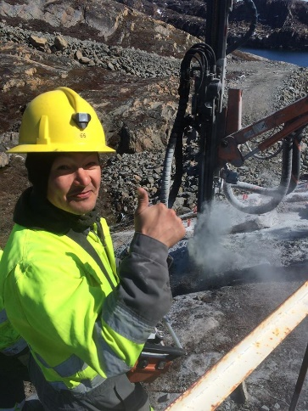
Canadian and international experiences
PDAC 2019
Hans Hinrichsen, General Manager, Greenland School of Minerals & Petroleum
Qujanoq
Thank you

